Slide 1
ENWR 513
Solid and Hazardous Waste Management
7. Disposal of Solid Waste and
Residual Matter - Landfills
Dr. Ranjna Jindal

Slide 2
Lecture Outline
Disposal of Solid Wastes and Residual Matter
Land Disposal of Solid Wastes
  Open Dumping
  Controlled Tipping
  Sanitary Landfilling
The Landfill Method of Solid Waste Disposal
Landfill Classification and Types
Landfilling Methods

Slide 3
7.1 Disposal of Solid Wastes and Residual
Matter
Enormous amounts of solid wastes are being produced by:
        the ever growing populations
coupled (together) with:
        raised living standards,
        rapid modernization, and
        complex industrial activities, etc.,
in every country of the world.
The very big question faced by each local or central government, at present, is: what to do with so much waste? or how to manage the solid wastes in a proper way?

Slide 4
Even after extensive scavenging of useful materials, very huge quantities of solid wastes remain to be disposed of in every city in every country of the world.
Solid waste residues are waste materials:
        that are not recycled,
        that remain after processing at a materials recovery facility, or
        that remain after the recovery of conversion products and/or energy e.g. incineration process ashes.
Historically, solid wastes have been placed in the soil in the earth’s crust (land disposal) or deposited in the oceans.

Slide 5
Unfortunately, despite some awareness of the problems associated with improper solid waste disposal, general public in many poor and developing countries around the world including in Asia, is still unmindful of its crude ways of disposing the wastes.
Large amounts of solid wastes are still carelessly dumped on land or in waterways causing severe environmental and public health hazards.
The safe and reliable long-term disposal of solid waste residues is an important component of integrated waste management.
Land disposal of solid waste residues include:
        open dumping,
        controlled tipping, and
        sanitary landfilling.

Slide 6
7.2 Land Disposal of Solid Wastes
i) Open Dumping
The most common method of disposing solid wastes in Asian region is by crude open dumping.
The disposal sites rarely meet the hygienic, environmental, and public health requirements.
In most cases, final disposal of wastes receives very little attention.
This situation predominantly is due to the lack of awareness, enough resources and suitable technology.
With the exceptions of a few countries like Japan, Singapore etc., all Asian countries practice open dumping for municipal solid waste disposal.

Slide 7
ii) Controlled Tipping
If the land disposal is practiced at regularly managed sites, using earth moving equipment to spread wastes and place daily cover, it can be termed as "controlled tipping".
iii) Sanitary Landfilling
Sanitary landfilling, in the true sense, is the land disposal similar to controlled tipping with additional environmental protection measures, e.g.
        hydrogeologically secured sites,
        leachet control for ground water safety, and
        surface water protection, etc.

Slide 8
The major countries that practice landfill disposal for solid wastes, are United Kingdom, Canada, Germany, United States, France and Japan.
The United Kingdom ranks highest, burying about 90 percent of its solid waste in landfills.
The United States ranks in the middle of the major countries practicing landfill disposal.

Slide 9
7.3 The Landfill Method of Solid Waste
Disposal
Even with implementation of waste reduction, recycling, and transformation technologies, disposal of residual solid waste still remains an important component of an integrated solid waste management strategy.
Historically, landfills have been the most economical and environmentally acceptable method for the disposal of solid wastes throughout the world.
What is a Landfill?
There are two ways to bury trash:
Dump or Open Dump: an open hole in the ground where
trash is buried and that has various
animals (rats, mice, birds) around.
This is most people's idea of a landfill!

Slide 10
However, it is not landfilling but just open dumping.
Landfill: carefully designed structure built into or
on top of the ground in which trash is
isolated from the surrounding
environment (groundwater, air, rain).
A dump implies simply leaving solid wastes in a localized area, with no caring for the final condition of the dumped materials.
A landfill is called “sanitary landfill”, if it is the type that protects the surrounding soil, air and water from pollution caused by the waste in the landfill.

Slide 11
This is accomplished via a number of techniques, including underlying the solid wastes with clay (or any other type of liner) and daily covering the waste with soil.
The isolation of waste is accomplished with a bottom liner and daily covering of soil.
The purpose of a landfill is to bury the trash in such a way that it will be isolated from groundwater, will be kept dry and will not be in contact with air.
Under these conditions, trash will not decompose much.
A landfill is not like a compost pile, where the purpose is to bury trash in such a way that it will decompose quickly.

Slide 12
7.3.1 The Landfilling Process
Definition of Terms
Landfills - are the physical facilities used for the
disposal of residual solid wastes in the
surface soils of the earth.
In the past, the term sanitary landfill was used to denote a landfill in which the waste placed in the landfill and was covered at the end of each day’s operation.
Sanitary Landfill - now refers to an engineered facility
for the disposal of MSW designed
and operated to minimize public
health and environmental impacts
(Figure7.1).

Slide 13
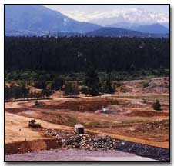
Figure 7.1 Sanitary Landfill

Slide 14
Sanitary landfills are sites where waste is isolated from the environment until it is safe.
The waste is considered safe when it has completely degraded biologically, chemically and physically.
  Sanitary Landfill - landfill that uses a clay or any synthetic material liner to isolate the trash from the environment.
  Municipal Solid Waste (MSW) Landfill - uses a synthetic (plastic) liner to isolate the trash from the environment.
Landfill management incorporates the planning, design, operation, closure, and post-closure control of landfills.

Slide 15
Landfilling
It is the process by which residual solid is placed in a landfill.
Sanitary Landfilling
Process of sanitary landfilling includes: (Figure 7.2)
        monitoring of the incoming waste stream,
        placement and compaction of the waste, and
        installation of landfill environmental monitoring
        and control facilities.
Secure Landfills - landfills for the disposal of hazardous
wastes are called secure landfills.

Slide 16
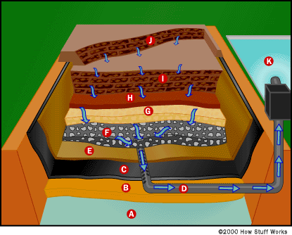
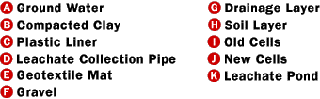
Figure 7.2 . This cross-section drawing shows the structure of a
municipal solid waste landfill. The arrows indicate the
flow of leachate.

Slide 17
The basic parts of a landfill, as shown in Figure 7.2, are:
  Bottom liner system - separates trash and subsequent leachate
  (liquids flow from wastes) from
  groundwater (B, C and E in Fig 7.2)
  Cells (old and new) - where the trash is stored within the landfill
  (I and J in Fig. 7.2)
  Daily cover - once the cell is made, it is covered with
  six inches of soil and compacted (H in Fig)
  Storm water drainage system - collects rain water that falls on
  the landfill (G in Fig)
  Leachate collection system - collects water that has percolated
  through the landfill itself and
  contains contaminating
  substances (leachate) (D in Fig)
  Methane collection system - collects methane gas that is formed
  during the breakdown of trash
  Covering or cap - seals off the top of the landfill

Slide 18
Each of these parts is designed to address specific problems that are encountered in a landfill.
So, as we discuss each part of the landfill, we'll explain what problem is solved.
(i) Bottom Liner System
A landfill's major purpose and one of its biggest challenges is to contain the trash so that the trash doesn't cause problems in the environment.
The bottom liner prevents the trash from coming in contact with the outside soil, particularly the groundwater.
Landfill liners are materials (both natural and manufactured) that are used to line the bottom area and below-grade sides of a landfill.

Slide 19
Liners usually consist of layers of compacted clay and/or geomembrane material designed to prevent migration of landfill leachate and landfill gas.
In MSW landfills, the liner is usually some type of durable, puncture-resistant synthetic plastic (polyethylene, high-density polyethylene, polyvinylchloride -PVC).
It is usually 30-100 mm thick.
The plastic liner may also be combined with compacted clay soils as an additional liner.
Optionally, the plastic liner may be surrounded on either side by a fabric mat (geotextile mat) that will help to keep the plastic liner from tearing or puncturing from the nearby rock and gravel layers.

Slide 20
(ii) Cells (Old and New)
Perhaps, the most precious commodity and overriding problem in a landfill is air space.
The amount of space is directly related to the capacity and usable life of the landfill.
If you can decrease the air space, then you can extend the usable life of the landfill.
To do this, trash is compacted into areas, called cells, that contain only one day's trash.
Cell - the term cell is used to describe the volume of material placed in a landfill during one operating period, usually one day.

Slide 21
The amount of trash within the cell is compressed by heavy equipment (tractors, bulldozers, rollers and graders) that go over the mound of trash several times) (Figure 7.3).
(iii) Daily cover
A cell includes the solid waste deposited and the daily cover material surrounding it.
Once the cell is made, it is covered with six inches of soil and compacted further.
In addition to compressing the trash into cells, space is conserved by excluding bulky materials, such as carpets, mattresses, foam and yard waste, from the landfill.

Slide 22
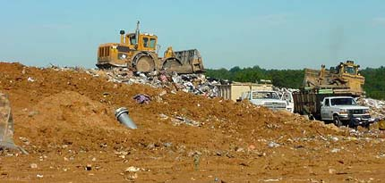
Figure 7.3 A bulldozer prepares a new cell in a landfill

Slide 23
Daily cover usually consists of 6 to 12 “ (15 to 30 cm) of native soil or alternative materials such as compost that are applied to the working faces of the landfill at the end of each operating period.
The purposes of daily cover are:
        to control the blowing of waste materials;
        to prevent rats, flies, and other disease vectors from entering or exiting the landfill; and
        to control the entry of water into the landfill during operation.
Cells are arranged in rows and layers of adjoining cells (lifts).
A lift is a complete layer of cells over the active area of the landfill (Figure 7.4).

Slide 24
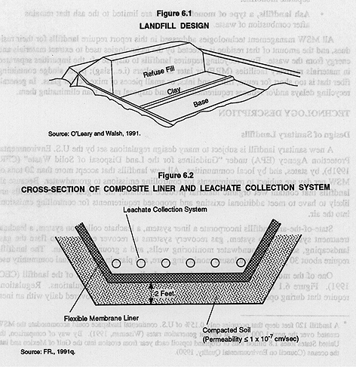
Figure 7.4 Schematics of Sanitary Landfill

Slide 25
Typically, landfills are comprised of a series of lifts.
A bench (or terrace) is commonly used where the height of the landfill will exceed 50 to 75 ft (15 to 22.5 m).
Benches are used:
        to maintain the slope stability of the landfill,
        for the placement of surface water drainage channels, and
        for the location of landfill gas recovery piping.

Slide 26
(iv) Storm Water Drainage
It is important to keep the landfill as dry as possible to reduce the amount of leachate.
This can be done in two ways:
(1) Excluding Liquids from the Solid Waste.
Solid waste must be tested for liquids before entering the landfill.
This is done by passing samples of the waste through standard paint filters.
If no liquid comes through the sample after 10 minutes, then the trash is accepted into the landfill.

Slide 27
(2) Keeping Rainwater Out of the Landfill
To exclude rainwater, the landfill has a storm drainage system.
Plastic drainage pipes and storm liners collect water from areas of the landfill and channel it to drainage ditches surrounding the landfill's base (Figure 7.5).
The ditches are either concrete or gravel-lined and carry water to collection ponds to the side of the landfill (Figure 7.6).
In the collection ponds, suspended soil particles are allowed to settle and the water is tested for leachate chemicals (Figure 7.7).
Once settling has occurred and the water has passed tests, it is then pumped or allowed to flow off-site.

Slide 28
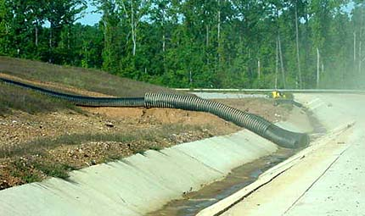
Figure 7.5 Storm drainage pipe empting into a drainage ditch

Slide 29
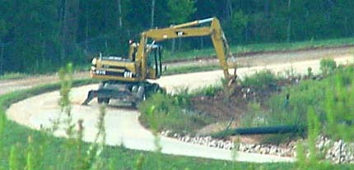
Figure 7.6 Drainage ditches running along the base of a landfill.
The black pipe carries landfill gas to a pumping station.

Slide 30
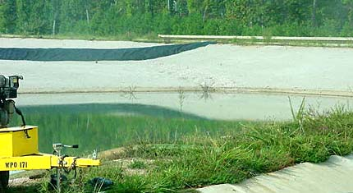
Figure 7.7 This collection pond is for catching storm water. The black liner helps channel the water and protect the underlying cells

Slide 31
(v) Leachate Collection System
No system to exclude water from the landfill is perfect and water does get into the landfill.
The water percolates through the cells and soil in the landfill much as water percolates through ground coffee in a drip coffee maker.
As the water percolates through the trash, it picks up contaminants (organic and inorganic chemicals, metals, biological waste products of decomposition) just as water picks up coffee in the coffee maker.
This water with the dissolved contaminants is called leachate and is typically acidic.

Slide 32
The liquid that collects at the bottom of a landfill is known as leachate.
Leachate contains a variety of chemical constituents:
        derived from the solublization of the materials deposited in the landfill,
        and from the products of the chemical and biochemical reactions occurring within the landfill.
In general, leachate is a result of:
        the percolation of precipitation through surface soil,
        uncontrolled runoff, and
        irrigation water into the landfill.
Leachate can also include water initially contained in the waste as well as infiltrating groundwater.

Slide 33
To collect leachate, perforated pipes run throughout the landfill.
These pipes then drain into a leachate pipe, which carries leachate to a leachate collection pond (Figure 7.8).
The leachate in the pond is tested for acceptable levels of various chemicals (biological and chemical oxygen demands, organic chemicals, pH, calcium, magnesium, iron, sulfate and chloride) and allowed to settle.
After testing, the leachate must be treated like any other sewage/wastewater; the treatment may occur on-site or off-site.
In deep landfills, leachate is collected at intermediate points.

Slide 34
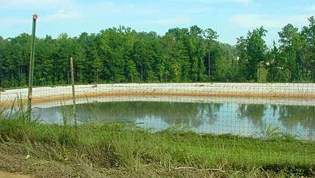
Figure 7.8 A leachate collection pond is designed to catch the contaminants
that can get into water that goes through the trash in a landfill.

Slide 35
(vi) Landfill Gas Collection System
Landfill gas is the mixture of gases found within a landfill due to various reactions taking place in the landfill.
The bulk of landfill gas consists of:
        methane (CH₄), and
        carbon dioxide (CO₂),
the principal products of the anaerobic decomposition of the biodegradable organic fraction of the MSW in the landfill.
Other components of landfill gas include:
        atmospheric nitrogen, and
        oxygen,
        ammonia, and
        trace organic compounds.

Slide 36
Methane Collection System
Bacteria in the landfill break down the trash in the absence of oxygen (anaerobic) because the landfill is airtight.
A byproduct of this anaerobic breakdown is landfill gas, which contains approximately 50 percent methane and 50 percent carbon dioxide with small amounts of nitrogen and oxygen.
This presents a hazard because the methane can explode and/or burn.
So, the landfill gas must be removed.
To do this, a series of pipes are embedded (inserted) within the landfill to collect the gas (Figure 7.9).
In some landfills, this gas is vented or burned (Figure 7.10).

Slide 37
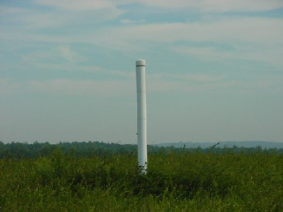
Figure 7.9 A methane collection pipe helps capture the hazardous gas

Slide 38
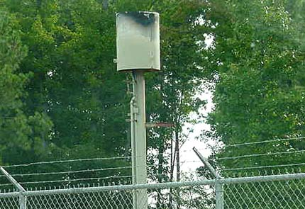
Figure 7.10 A methane "flare" is used for burning landfill gas

Slide 39
More recently, it has been recognized that this landfill gas represents a usable energy source.
The methane can be extracted from the gas and used as fuel.
As an example in a municipal solid waste landfill in USA, a company collects the landfill gas, extracts the methane, and sells it to a nearby chemical company to power its boilers.
The extraction system is a split system, meaning that methane gas can go to the boilers and/or the methane flares that burn the gas.

Slide 40
The reason for the split system is that the landfill will increase its gas production over time (from 300 cubic feet per minute to 1,250 cubic feet per minute) and thus would exceed the capacity of the boilers at the chemical company.
Therefore, the excess gas will have to be burned.
It is not cost-effective to compress the excess gas to liquid and sell it.
(vii) Covering or Cap
As mentioned above, each cell is covered daily with six inches of compacted soil.

Slide 41
This covering seals the compacted trash from the air and prevents pests (birds, rats, mice, flying insects, etc.) from getting into the trash.
This soil takes up quite a bit of space.
Because space is a precious commodity, many landfills are experimenting with tarps or spray coverings of paper or cement/paper emulsions.
These emulsions can effectively cover the trash, but take up only a quarter of an inch instead of 6 inches!
Figure 7.11 shows an experimental tarp provides daily cover of the landfill cells
Figures 7.12 -7.13 show the cross sectional diagrams of a modern sanitary landfill

Slide 42
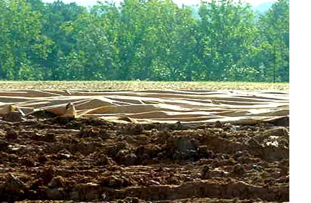
Figure 7.11 An experimental tarp provides daily cover of the
landfill cells.

Slide 43
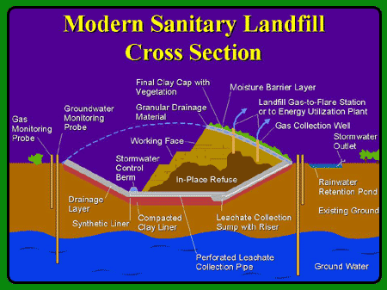
Figure 7.12 Cross Section of a Modern Sanitary Landfill

Slide 44
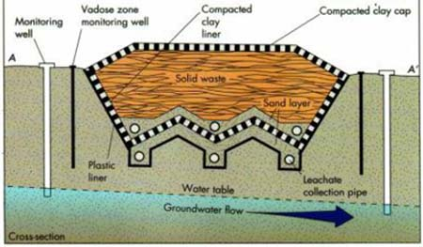
Figure 7.13 Cross Section of a Modern Sanitary Landfill

Slide 45
The final lift includes the cover layer which is applied to the entire landfill surface after all landfilling operations are complete.
The final cover usually consists of multiple layers of soil and/or geomembrane materials designed to:
        enhance surface drainage,
        intercept percolating water, and
        support surface vegetation.

Slide 46
When a section of the landfill is finished, it is covered permanently with a polyethylene cap (40 mil).
The cap is then covered with a 2-foot layer of compacted soil.
The soil is then planted with vegetation to prevent erosion of the soil by rainfall and wind (Figure 7.14).
The vegetation consists of grass and kudzu.
No trees, shrubs or plants with deep penetrating roots are used so that the plant roots do not contact the underlying trash and allow leachate out of the landfill.

Slide 47
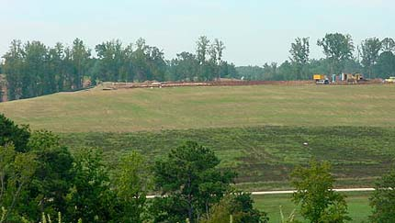
Figure 7.14 Grass and other plants cover the municipal solid waste
landfill.

Slide 48
The goal for the design and operation of a modern landfill is to eliminate or minimize the impacts associated with these concerns.
7.4 Landfill Classification, Types, and
Methods
The purpose of this section is to introduce the
(1) a commonly used landfill classification system,
(2) the different types of landfills that are now used, and
(3) the different landfilling methods that are used in various parts of
world.

Slide 49
7.4.1 Classification of Landfills
Although a number of landfill classification systems have been proposed over the years, the classification system adopted by the state of California in USA in 1984 is perhaps the most widely accepted classification system for landfills.
In the California system, three classifications are used as shown below :
__________________________________ Classification Type of waste
_______________________________________________________________________________________________________________________________
I Hazardous waste
II Designated waste
III Municipal solid waste (MSW)
________________________________________________________________________________________________________________________________

Slide 50
Designated wastes are nonhazardous wastes that may release constituents in concentrations that exceed applicable water quality objectives.
Note that this classification system focuses primarily on the protection of surface and groundwater rather than landfill gas migration or air quality.
7.4.2 Major Types of Landfills
The principal types of landfills can be classified as:
(1) conventional landfills for commingled MSW,
(2) landfills for shredded (milled) solid wastes, and
(3) monofills for designated or specialized wastes.

Slide 51
(1) Landfills for Commingled MSW
The majority of the landfills throughout the United States are designed for commingled MSW.
In many of these Class III landfills, limited amounts of nonhazardous industrial wastes and sludge from water and wastewater treatment plants are also accepted.
In many states, treatment plant sludges are accepted if they are dewatered to a solids content of 51 percent or greater.
In most cases, native soil is used as the intermediate and final cover material.

Slide 52
However, in locations where the amount of native soil available for use as intermediate cover material is limited, alternative materials such as:
        compost produced from yard wastes and MSW,
        foam,
        old rugs and carpeting,
        dredging spoils, and
        demolition wastes
have been used for the purpose.
To obtain additional landfill capacity, abandoned and or closed landfills in some locations are being reused by excavating the decomposed material to recover the metals and using the decomposed residue as daily cover for the new wastes.
In some cases, the decomposed wastes are excavated and stockpiled, and a liner is installed before the landfill is reactivated.

Slide 53
(2) Landfills for Shredded Solid Wastes
An alternative method of landfilling that is being tried in several U.S. locations involves shredding of the solid wastes before placement in a landfill.
Shredded (or milled) waste can be placed at up to 35 percent greater density than unshredded waste, and without daily cover in some state regulations.
Blowing litter, odors, flies, and rats have not been significant problems.
Because shredded waste can be compacted to a tighter and more uniform surface, a reduced amount of soil cover or some other cover material may be sufficient to control infiltration of water during the fill operation.

Slide 54
Disadvantages of this method include the need for a shredding facility and the need to operate a conventional landfill section for wastes that cannot be easily shredded.
The shredded waste method has potential application in areas:
        where landfill capacity is very expensive (because of the greater compaction obtainable),
        where suitable cover material is not readily available, and
        where precipitation is very low or highly seasonal.
Shredded waste can also be used to produce compost that can be used as intermediate cover material.

Slide 55
(3) Landfills for Individual Waste Constituents
Landfills for individual waste constituents are known as monofills.
Combustion ash, asbestos, and other similar wastes, often identified as designated wastes, are typically placed in monofills to isolate them from materials placed in MSW landfills.
Because combustion ash contains small amounts of unburned organic material, the production of odors from the reduction of sulfate has been a problem in monofills used for combustion ash.
In monofills used for combustion ash, the installation of a gas recovery system is recommended to control odor problems.

Slide 56
7.4.3 Other Types of Landfills
In addition to the conventional methods of landfilling already described, other specialized methods of landfilling designed to enhance different goals of landfill management are being developed.
Alternative operational methods that are being used include:
(i) landfills designed to maximize the rate of landfill gas
generation, and
(ii) landfills operated as integrated solid waste treatment
units.
(iii) landfills in wetland areas
The practice of landfilling in wetland areas, now prohibited, is also described.

Slide 57
(i) Landfills Designed to Maximize Gas Production
If the quantity of landfill gas that is produced and recovered from the anaerobic decomposition of solid wastes is to be maximized, specialized landfill designs will be required.
For example, the use of deep, individually lined cells, in which the wastes are placed without intermediate layers of cover material and leachate is recycled to enhance the biological decomposition process, is a viable option.
A possible disadvantage of such a landfill is that excess leachate must ultimately be disposed of.

Slide 58
(ii) Landfills as Integrated Treatment Units
In this method of operation, the organic constituents would be separated out and placed in a separate landfill where the biodegradation rates would be enhanced by increasing the moisture content of the waste, either by recycling leachate or by seeding with digested wastewater treatment plant sludge or animal manure.
The degraded material would be excavated and used as cover material for new fill areas, and the excavated cell would be filled with new waste.

Slide 59
(iii) Landfills in Wetland Areas
In the past, landfilling in wetland areas, such as swamps, marshes, and tidal areas, was considered acceptable if adequate drainage was provided and if nuisance conditions did not develop.
Under current federal regulations, such destruction of wetland areas is prohibited, although the expansion of an existing landfill may be allowed under special conditions.
Because many landfills already exist in these areas, a brief description of the methods typically used in these fills is presented.
The usual practice in filling wetlands was to divide the area into cells or lagoons and schedule the filling operations so that one individual cell or lagoon would be filled each year.

Slide 60
Often, solid wastes were placed directly in the water.
Alternatively, clean fill material was added up to, or slightly above the water level before waste filling operations were started.
To withstand mud waves and to increase structural stability, dikes dividing the cells or lagoons were constructed with trees, tree limbs, lumber, demolition wastes, and similar materials in addition to clean fill material.
In some cases, to prevent the movement of leachate and gases from completed cells or lagoons, clay and lightweight interlocking steel or wood-sheet piling has been used.

Slide 61
7.5 Landfilling Methods
The principal methods used for the landfilling of MSW are:
(1) excavated cell/trench,
(2) area, and
(3) canyon.
The principal features of these types of landfills, illustrated in Figures 7.15 – 7.17 are described below.
(1) Excavated Cell/Trench Method
The excavated cell/trench method of landfilling (Figure 7.15 ) is ideally suited to areas where an adequate depth of cover material is available at the site and where the water table is not near the surface.

Slide 62
The trench method involves digging a wide, long hole in the existing ground so that the bottom of the trench is much lower than the surrounding ground level.
Typically, solid wastes are placed in cells or trenches excavated in the soil.
The soil excavated from the site is temporarily stockpiled, and is later used for daily and final cover.
The excavated cells or trenches are usually lined with synthetic membrane liners or low-permeability clay or a combination of the two to limit the movement of both landfill gases and leachate.
Excavated cells are typically square, up to 1000 ft in width and length, with side slopes of 1.5:1 to 2:1.
Trenches vary from 200 to 1000 ft in length, 3 to 10 ft in depth, and 15 to 50 ft in width.

Slide 63
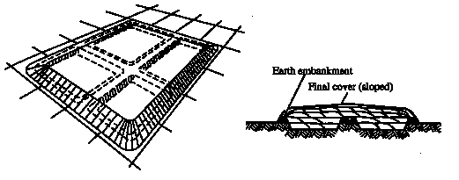
Figure 7.15 The Trench Method of Landfill

Slide 64
The waste is placed on the landfill liner, spread in layers, and driven over with compaction equipment.
Successive layers are built up until a depth of 3 to 4 m is achieved.
(2) Area Method
The area method is used when the terrain is unsuitable for the excavation of cells or trenches in which to place the solid wastes (Figure 7.16).
High-groundwater conditions necessitate the use of area-type landfills.
Site preparation includes the installation of a liner and leachate control system.

Slide 65
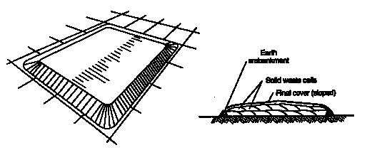
Figure 7.16 The Area Method of Landfill

Slide 66
Cover material must be hauled in by truck or earthmoving equipment from adjacent land or from borrow-pit areas.
As noted above, in locations with limited availability of material that can be used as cover, compost produced from yard wastes and MSW has been used successfully as intermediate cover material.
Other techniques that have been used include the use of movable temporary cover materials such as soil and geomembranes.
Soil and geomembranes, placed temporarily over a completed cell, can be removed before the next lift is begun.

Slide 67
(3) Cayon/Depression Method
The canyon method is similar to the trench method except natural depressions or canyons are used rather than digging trenches.
This can include filling old quarry sites.
Canyons, ravines, dry borrow pits, and quarries have been used for landfills (Figures 7.17 – 7.18).
The techniques to place and compact solid wastes in canyon/depression landfills vary with:
        the geometry of the site,
        the characteristics of the available cover material,
        the hydrology and geology of the site,
        the type of leachate and gas control facilities to be used, and
        the access to the site.

Slide 68
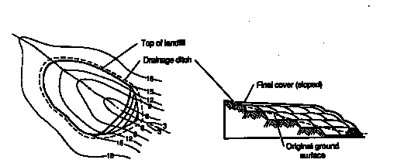
Figure 7.17 The Canyon Method of Landfill

Slide 69
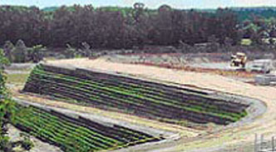
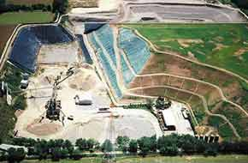
Figure 7.18 The Canyon Method of Landfill

Slide 70
Control of surface drainage often is a critical factor in the development of canyon/depression sites.
Typically, filling for each lift starts at the head end of the canyon and ends at the mouth, so as to prevent the accumulation of water behind the landfill.
Canyon/depression sites are filled in multiple lifts, and the method of operation is essentially the same as the area method described above.
If a canyon floor is reasonably flat, the initial landfilling may be carried out using the excavated cell/trench method discussed previously.

Slide 71
A key to the successful use of the canyon/depression method is the availability of adequate material to cover the individual lifts as they are completed and to provide a final cover over the entire landfill when the final height is reached.
Cover material is excavated from the canyon walls or floor before the liner system is installed.
Borrow pits and abandoned quarries may not contain sufficient soil for intermediate cover, so that cover material may have to be imported.
Compost produced from yard waste and MSW can be used for the intermediate cover layers.

